Slide 1

Traditional MLR and advanced ML based statistical downscaling:
a reliable tool for regional impact assessemnt studies
Prof.(Dr.) Lalu Das
Dean, F/Ag, BCKV & POC, WCRP-CORDEX, South Asia Domain
Department of Agricultural Meteorology and Physics
Bidhan Chandra Krishi Viswavidyalaya,
Mohanpur, Nadia, West Bengal
ICRC-CORDEX 2023 International Conference during 25-29 September, 2023 at IITM Pune, India

Slide 2
Background
Global ocean–atmosphere coupled models (GCMs) are the primary tool normally provide long-term and short term climatic information, in addition to provide weather information on medium range (valid for 4-10 days), extended range (valid for 10-30 days) seasonal scale (valid for 1-3 months)
However, these models suffer from substantial biases (when compared with surface observations) and are unable to provide useful information at the regional or local scales required in a number of sectors such as agriculture, hydrology, energy, health, tourism or insurance etc.
Therefore, an increasing demand by the multi-level stakeholders to have reliable forecast products at regional and local scales for accurately assessing impact of climate change on different economic sectors like agriculture, hydrology, energy etc.
So downscaling the numerical model outputs has been immerged as an alternative to provide an actionable products representing the local features for multi-sectorial applications as mentioned above

Slide 3
Science Questions?
Can we evaluate the suitability and added value of statistical downscaling methods for climate change applications?
How do we solve distillation issues from ESD/RCM/GCM ensembles?
Which downscaling methods (dynamical and statistical) will provide reliable information for impact assessment?

Slide 4
Why do we need downscaling ?
Different types of downscaling
Spatio-temporal downscaling through
A) Model Output Statistics (MOS)
B) Perfect Prognosis(PP)

Slide 5
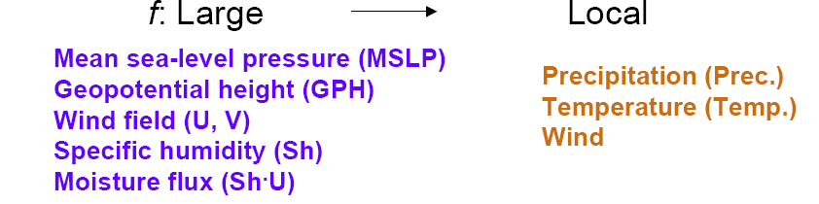
What is Downscaling?
Downscaling: obtaining sub grid-scale information from coarser resolution fields
Relationships between larger-scale climate variables (GCMS outputs) & local scale surface climate (station data)
Two assumptions of downscaling methods are:
              larger-scale variables are more reliably simulated
              relationships remain valid in a changed climate

Slide 6
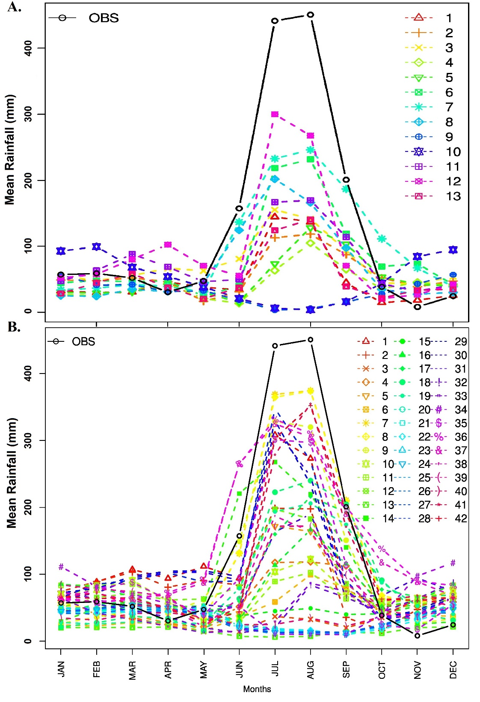
Why do we need downscaling ??
CMIP3
Comparison of seasonal cycles of two generations climate models
CMIP5

Slide 7
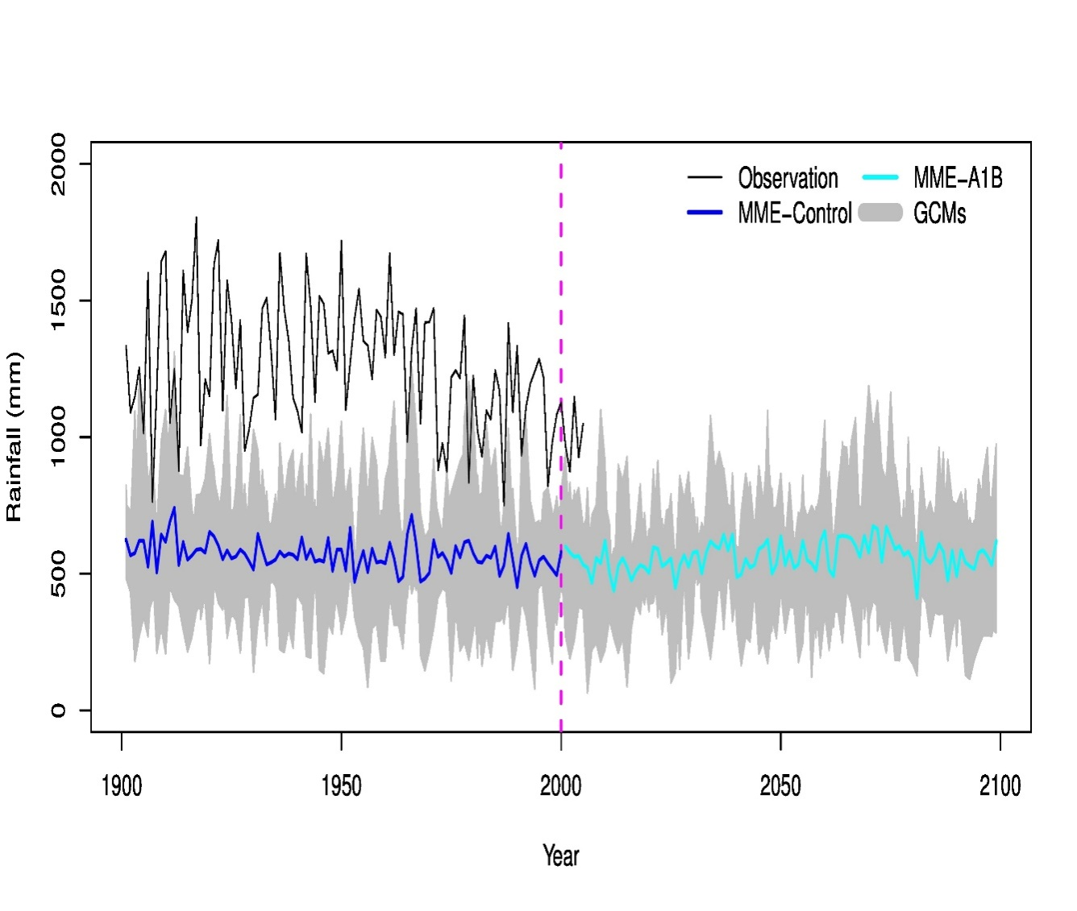
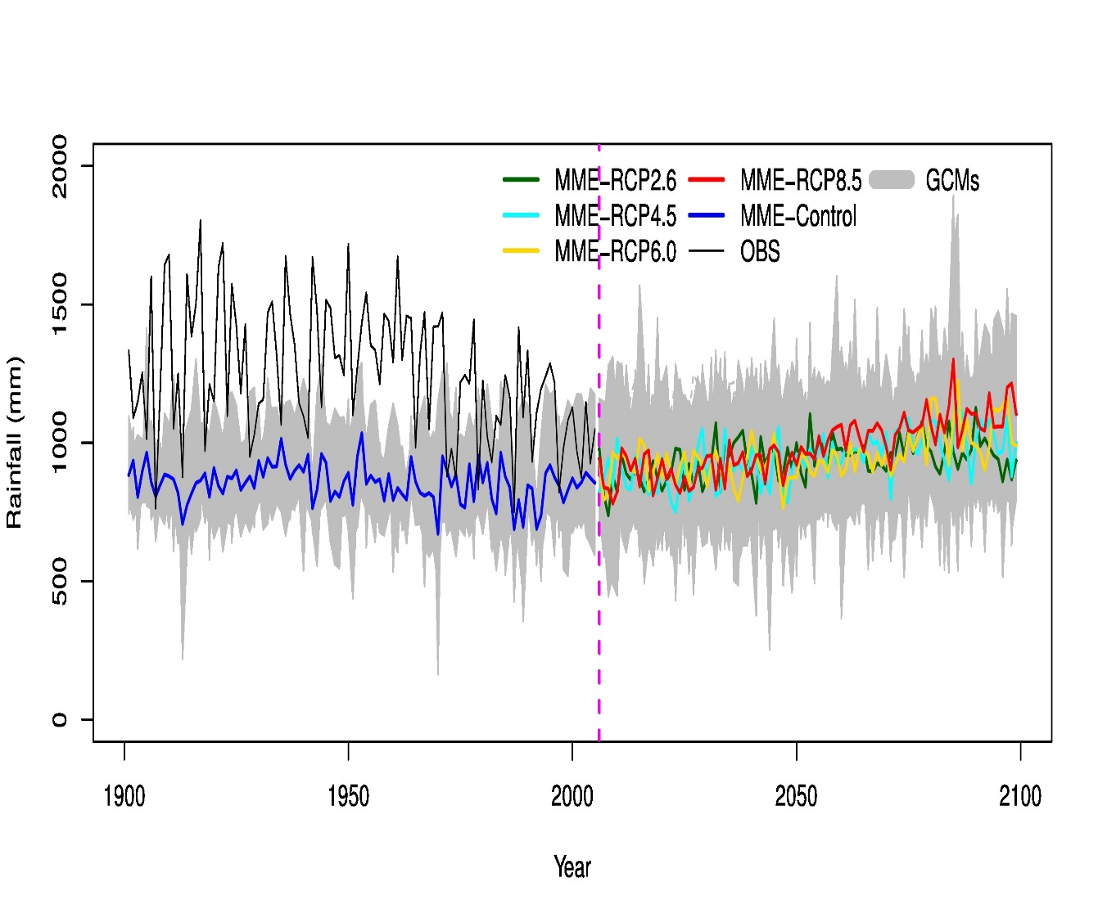
Why do we need downscaling?
CMIP3
CMIP5
Monsoon
Monsoon Rainfall projection in the future

Slide 8
Why do we need downscaling?

Slide 9
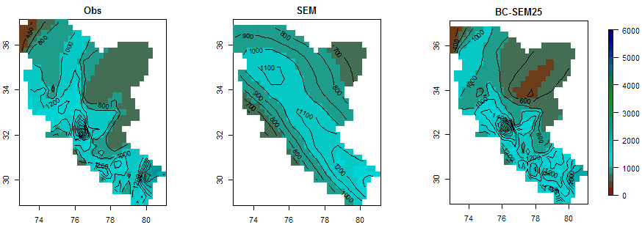
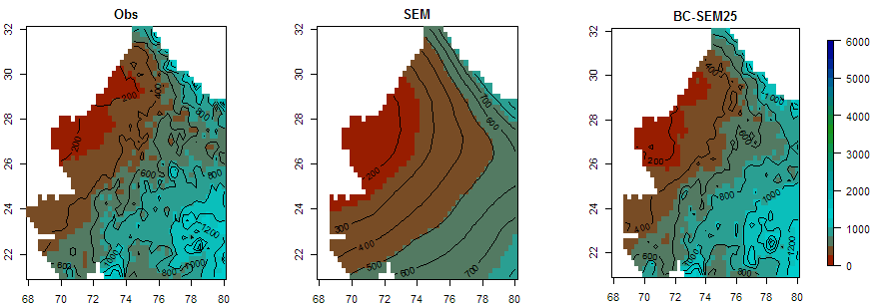
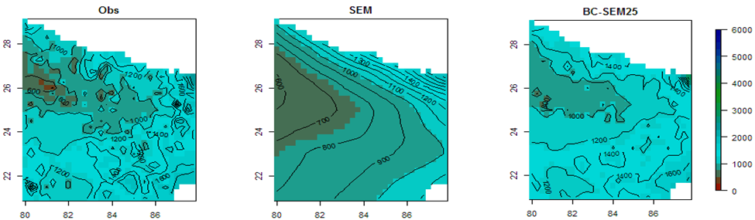
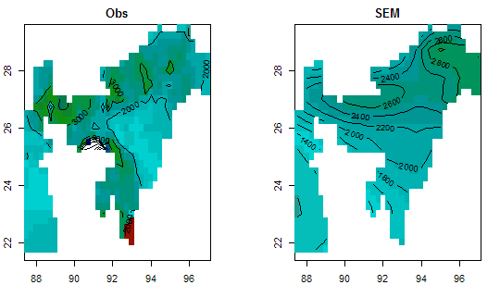
Observed and GCM simulated rainfall patterns
Lat(°N)
Lat(°N)
Lat(°N)
Lat(°N)
Lon(°E)
Lon(°E)
Lon(°E)
Lon(°E)
Lat(°N)
Lat(°N)
Lat(°N)
Lat(°N)
Lon(°E)
Lon(°E)
Lon(°E)
Lon(°E)
(Akhter et al., 2016; Clim. Dyn.)

Slide 10
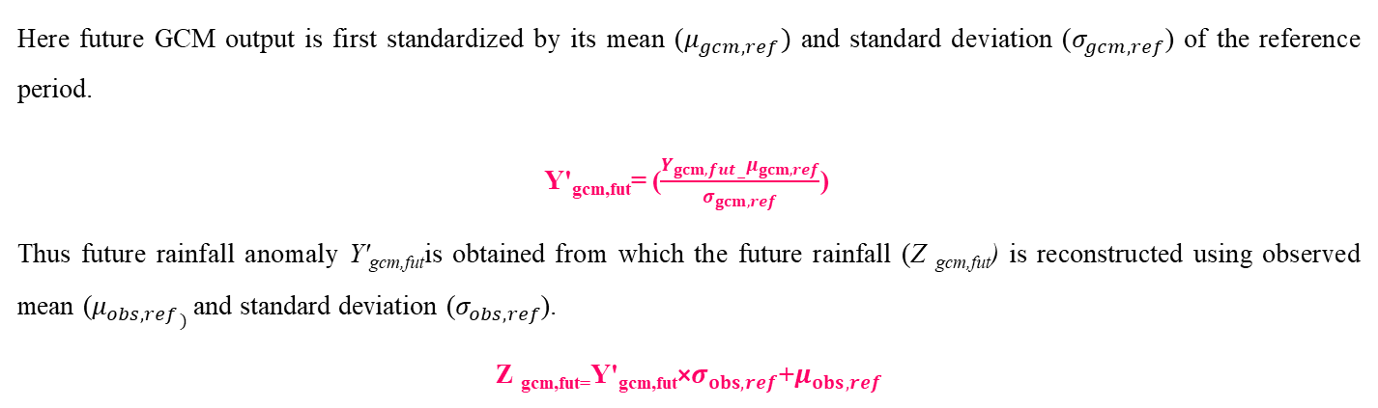
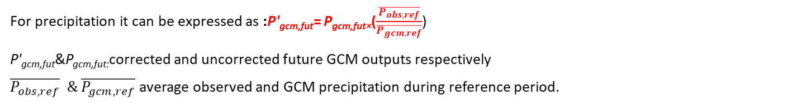
Downscaling : Model output statistics (MOS) method
Method 1: Scaling
For precipitation it can be expressed as :P'_{gcm,fut}= P_{gcm,fut×}($\frac{\overline{P_{obs,ref}}}{\overline{P_{gcm,ref}}}$)
P'_{gcm,fut}&P_{gcm,fut:}corrected and uncorrected future GCM outputs respectively
$\overline{P_{obs,ref}} \& \overline{P_{gcm,ref}}$average observed and GCM precipitation during reference period.
Method 2: Standardized reconstruction (SdRc)
Here future GCM output is first standardized by its mean ($μ_{gcm,ref})$ and standard deviation ($σ_{gcm,ref}$) of the reference period.
Y'_{gcm,fut}= ($\frac{Y_{gcm,fut}−μ_{gcm,ref}}{σ_{gcm,ref}}$)
Thus future rainfall anomaly Y'_{gcm,fut}is obtained from which the future rainfall (Z _{gcm,fut}) is reconstructed using observed mean ($μ_{obs,ref})$ and standard deviation ($σ_{obs,ref}$).
Z _{gcm,fut=}Y'_{gcm,fut}×$σ_{obs,ref}$+$μ_{obs,ref}$

Slide 11
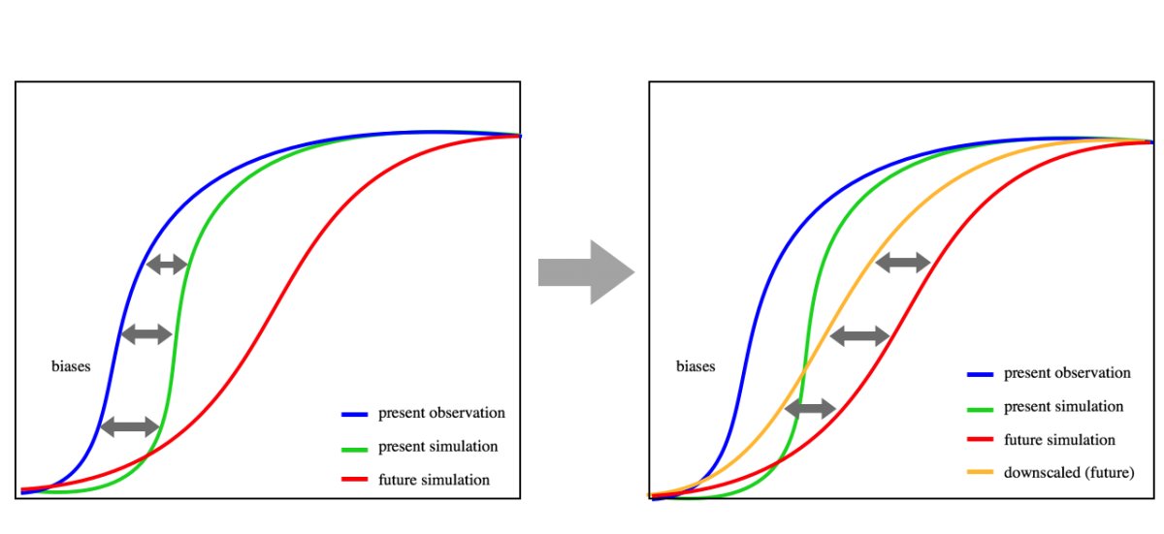
Model output statistics (MOS) method
Method 3: Quantile mapping
The transformation is deﬁned as: P_{o} = F⁻¹_{o}(F_{m} (P_{m}))
F_{m} : Cumulative Distribution Function (CDF) of P_{m} ; F_{o}⁻¹ :inverse CDF corresponding to P_{o}.
Gamma quantile Mapping (Gqm) based on the initial assumption that both observed and simulated intensity distributions approximated by gamma distribution applicable only to precipitation (Piani et al. 2010).
Empirical quantile mapping (Eqm) CDFs of observed and modelled precipitation estimated using empirical percentiles and values in between the percentiles approximated using linear interpolation (Gudmundsson et al., 2012).
https://rcmes.jpl.nasa.gov/content/statistical-downscaling

Slide 12
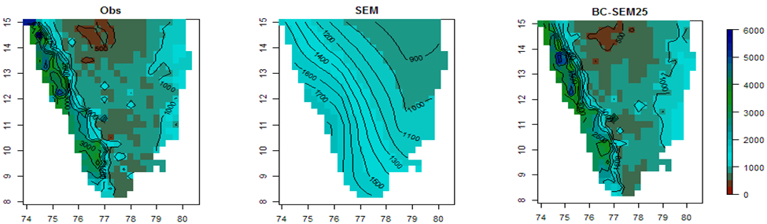
After downscaling through MOS
mm
Lat(°N)
Lat(°N)
Lat(°N)
Lon(°E)
Lon(°E)
Lon(°E)
(Akhter et al., 2016; Clim. Dyn.)

Slide 13
Skill of Numerical Weather Forecasting ( NWP) models in
a) Medium range (valid for 4-10 days),
b) Extended range (valid for 10-30 days)
c) Seasonal scale (valid for 1-3 months)

Slide 14
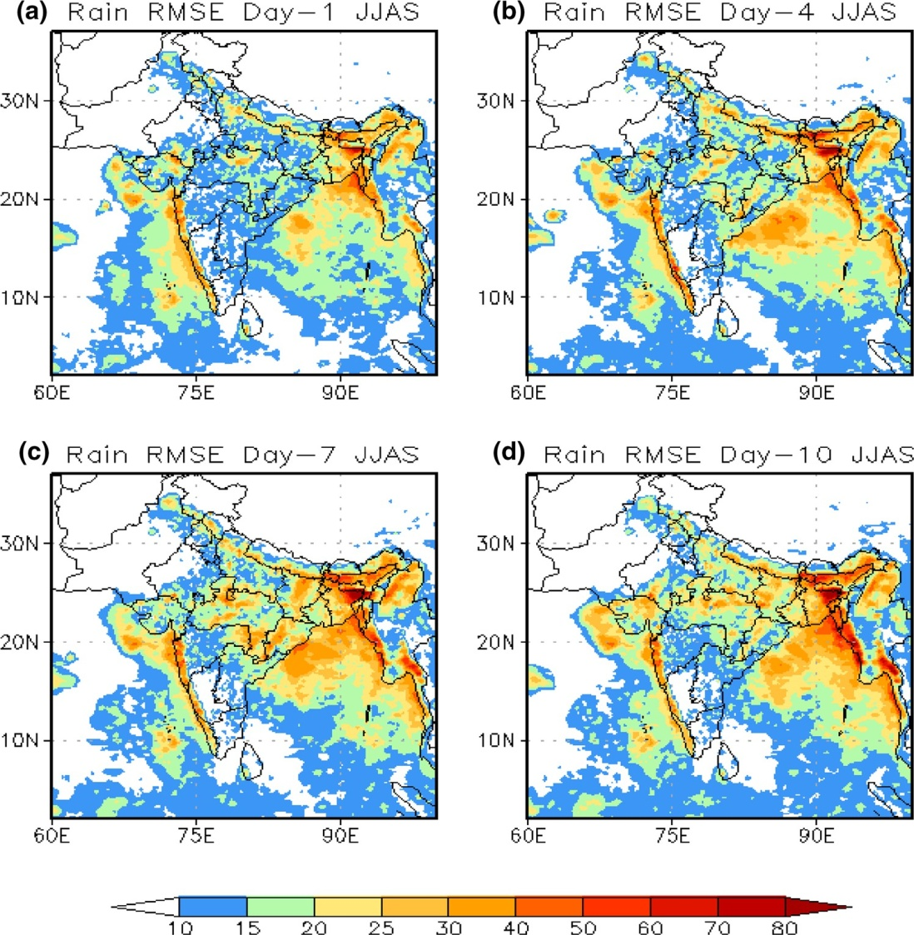
Performance checking of medium range weather forecast over India and GWB
regionUsing NCUM (UK-Met office Unified model) with resolution 17 Km
Root mean square errors (RMSE, mm/day) of model forecasted rainfall with respect to observed rainfall during June, July and August and September (JJAS) 2017 a day-1; b day-4; c day-7 and d day-10 forecasts
Over the east coast and adjoin­ing Bay of Bengal, RMSE values are about 30–40 mm/day in day-1 rainfall forecasts. As the forecast length increases, the RMSE magnitude increases over central and eastern parts of India up to day-7 forecast. In day-10 forecasts, the RMSEs are higher over the Gangetic plains as compared to day-1 or day-4 forecasts.
Kar et al.(2018), Climate dynamic

Slide 15
Skills of IMD Extended Range Forecast
Pentad wise anomaly correlation coefficient (ACC) of JJAS rainfall for all pentads during 2001-2014
Pentad wise Root Mean Skill Score (RMSS) of JJAS rainfall for all pentads during2001-2014
Relatively Lower Skills have been found over GWB
The state-of-the-art coupled model - Climate Forecast System Model Version 2 (CFSv2) with resolution T126 and T382
Source: Contribution from IITM
Research Report No. RR-137
ESSO/IITM/SERP/SR/01(2017)/188

Slide 16
Skills of IMD Seasonal Range Forecast
Low Correlation and high RMSE over GWB

Slide 17
Downscaling methods
Selection of Predictors
Should have plausible physical relationship with local scale predictand
Output available in global models
Well simulated by global models
From Re-analysis (PP)
Directly from model outputs (MOS)
Model development during hindcast period
Transfer functions:
For regression based linear and non-linear downscaling model:
Simple Linear Regression (LRM) or Multiple linear Regression(MLR)
Machine Learning techniques based downscaling model:
Principle Component Regression (PCR),
Support Vector Regression (SVR),
Random Forest (RF),
Artificial Neural Network (ANN)
Applying to model forecasts
In general downscaling models developed with
machine learning techniques perform better in comparison to downscaling models developed with traditional statistical regression techniques.
Owing to the learning abilities from data and their use in computer algorithms, techniques such as ANN, SVM, PCR, and RF are often called machine learning techniques
Get downscaled forecast
Verification of forecast (Deterministic and probabilistic)

Slide 18
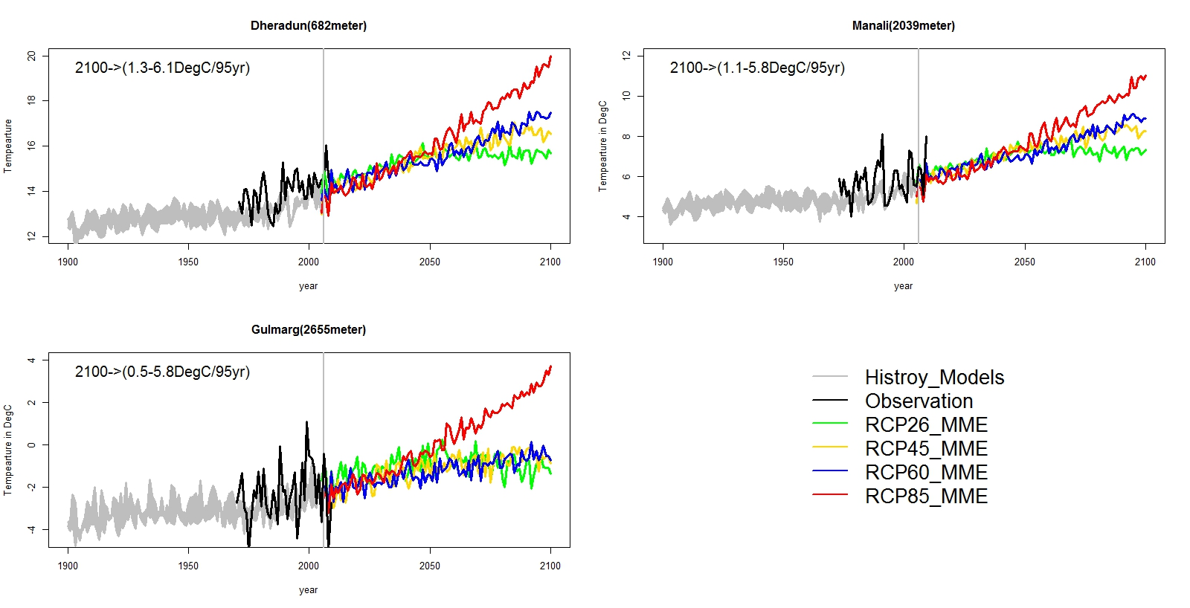
CMIP5 ensemble Downscaled winter temperature over station location

Slide 19
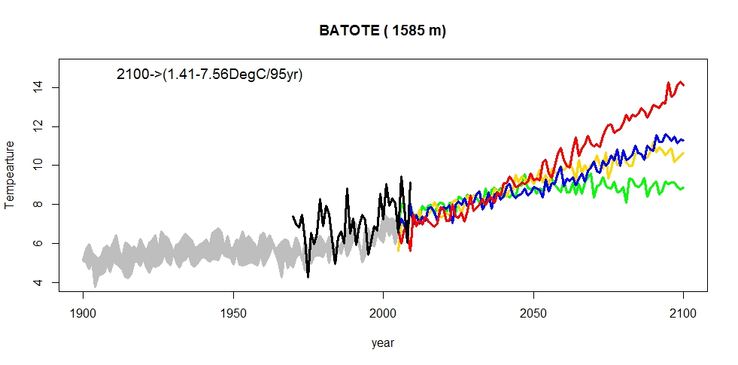
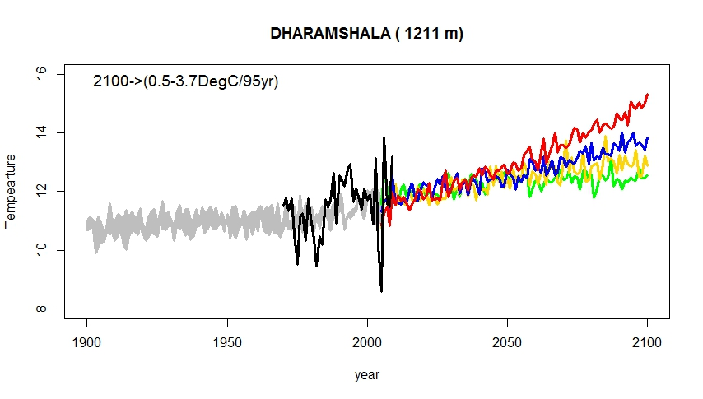
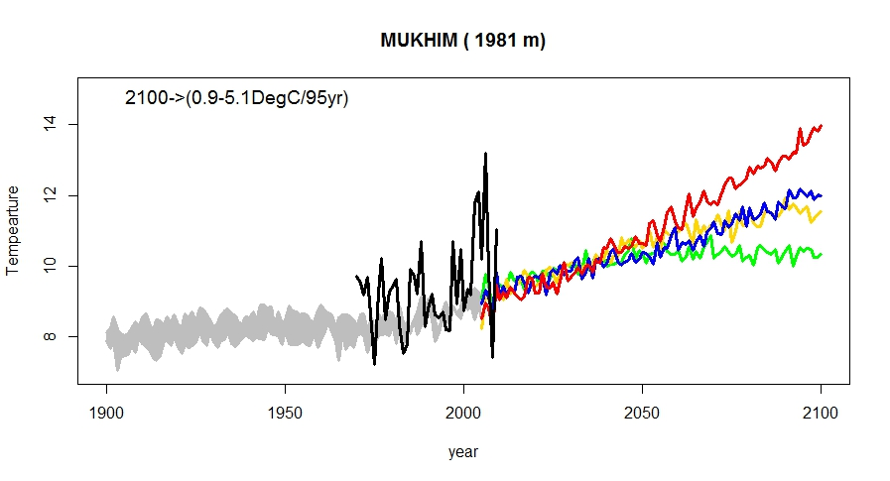
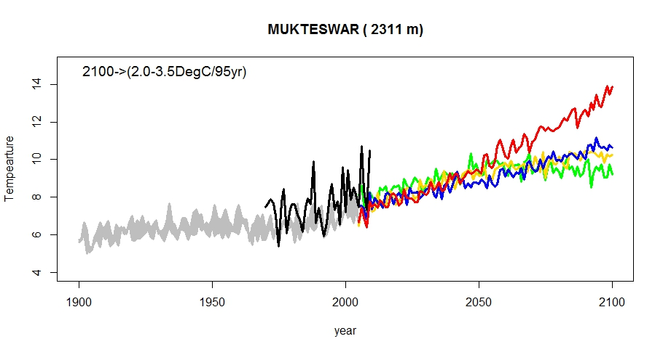
CMIP5 ensemble Downscaled winter temperature over station location

Slide 20
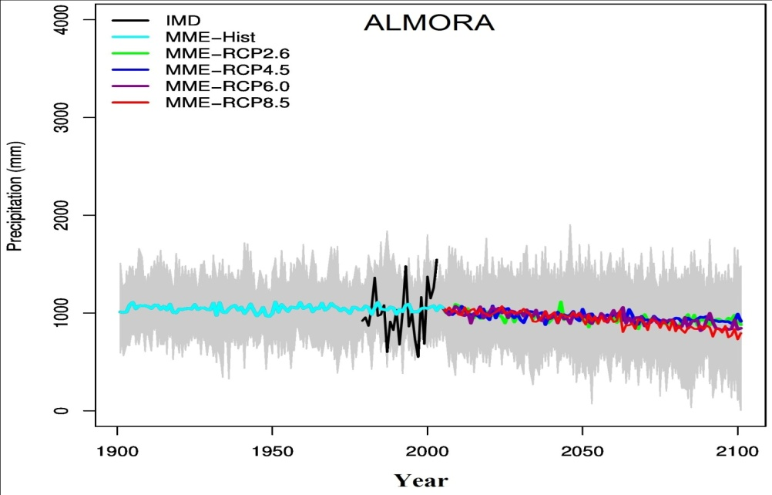
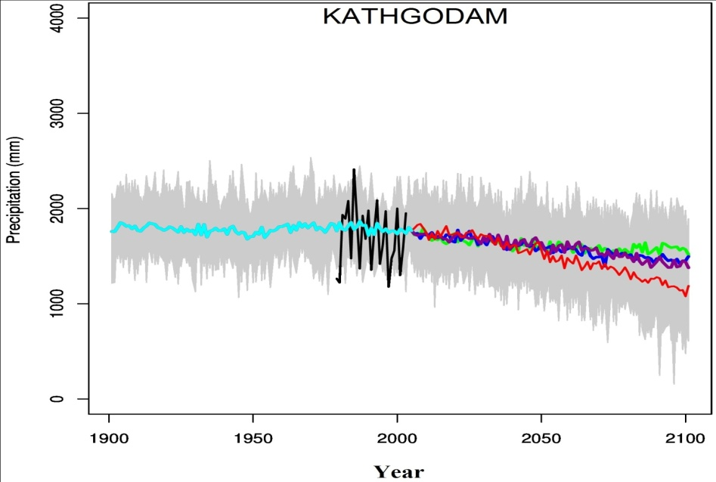
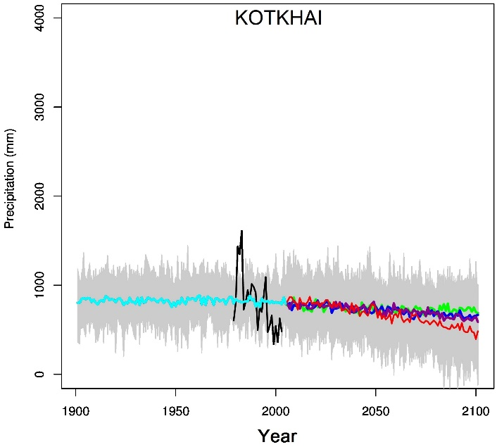
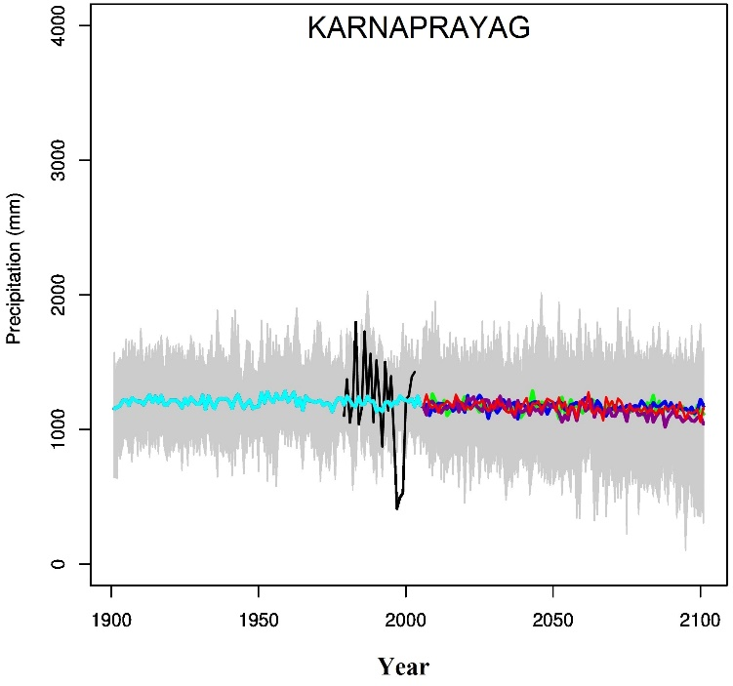
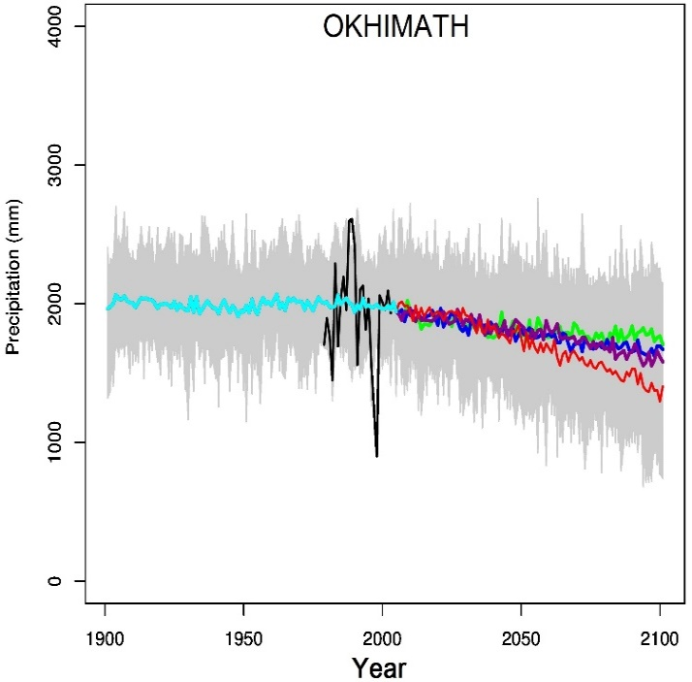
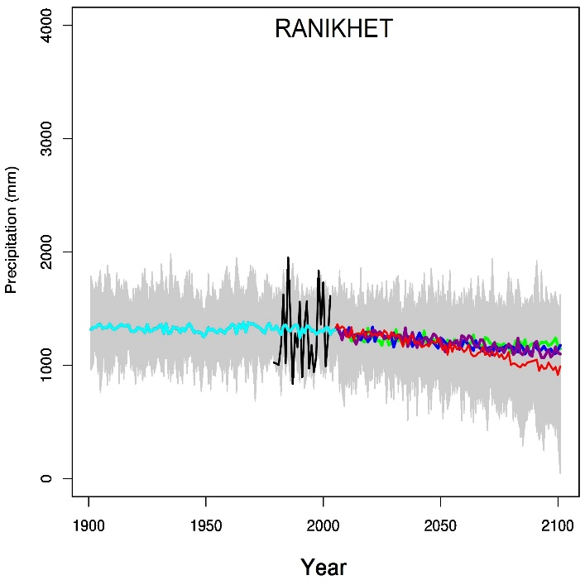
CMIP5 ensemble Downscaled annual rainfall over station location

Slide 21
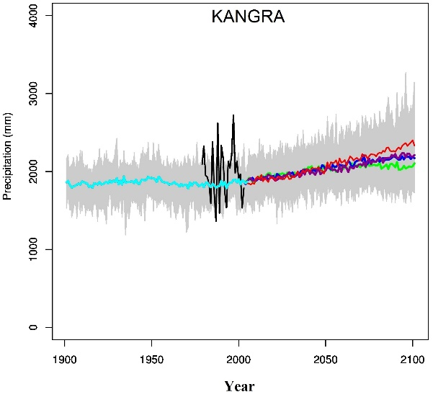
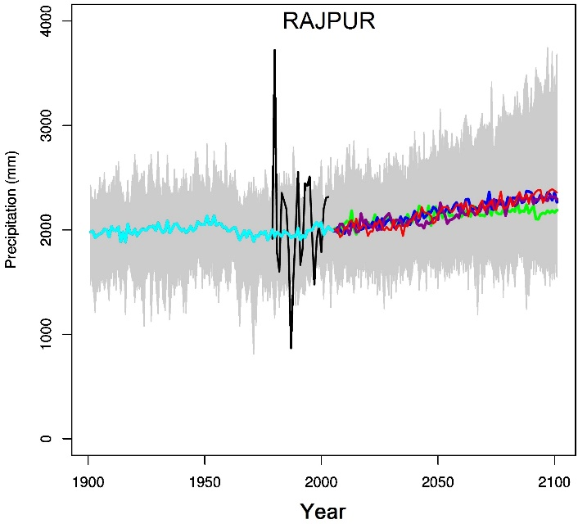
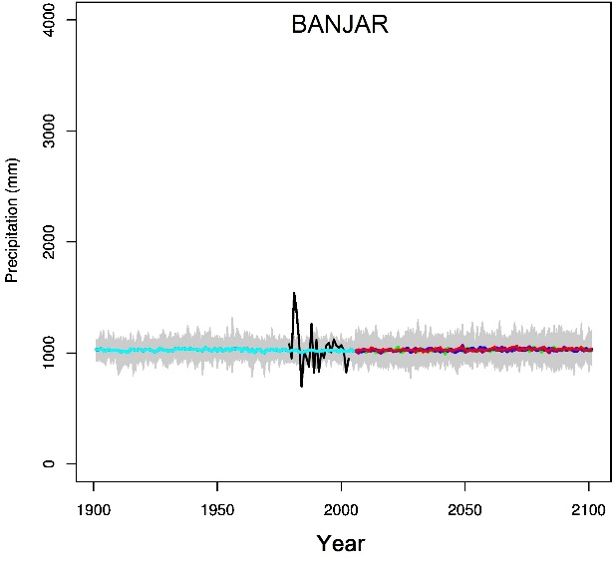
CMIP5 ensemble Downscaled annual rainfall over station location

Slide 22
Added Value Assessment
Major aim of any downscaling study is to assess the added values of the downscaled
forecast compared to raw forecast model outputs can be evaluated as
The added value of downscaling product would be judged through comparing the raw model outputs with downscaled the model outputs in the following three aspects:
By comparing the representativeness of the local mean climatology for without and with downscaling
2) Through comparing different statistical indices and model skills for with out downscaling and with downscaling
3) Comparing the ability of performance in particular extreme episodes in the past

Slide 23
Importance and Societal Implications
Deliverable 1 from downscaling:
At the end of above mentioned downscaling activities, medium range, extended range to seasonal range downscaled weather and climate forecasts will be available for multi-sectorial stakeholders and decision-makers for impact studies
Implications:
These high resolution downscaled weather and climate forecast data will also be used as reliable input for crop simulation models and hydrological models for better agricultural planning and water resource management practice at the local scale.

Slide 24
Importance and Societal Implications
Deliverable 2 from downscaling:
More reliable downscaled product (added valued) in terms less error and high agreement indices will be provided for multi-sectorial implications
Implications:
These reliable information will be benefited to
the farming community for preparing day-to-day agricultural planning
monitoring the surface and groundwater availability at local scales (point/station level) well in advance (a few days, weeks to months)

Slide 25
Importance and Societal Implications
Deliverable 3 of downscaling:
Improved downscaling results using advanced machine learning (ML) based approach compared to traditional multiple linear regression-based (MLR) approaches will available.
Implications:
These improved information will be benefited to different sectors like agriculture, water resource management by providing reliable input for
day-to-day agricultural planning at field level (point or station level)
monitoring the surface and groundwater availability at local scales well in advance (a few days, weeks to months)

Slide 26
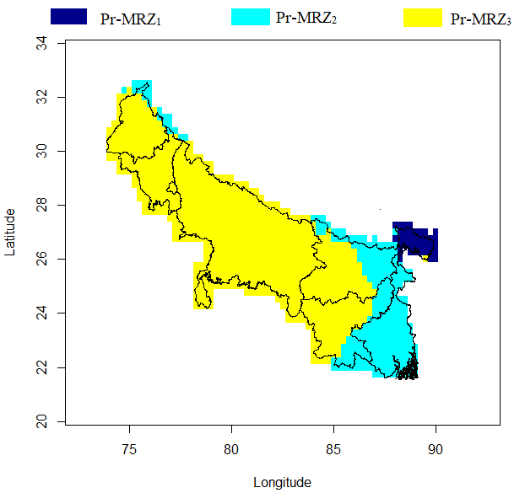
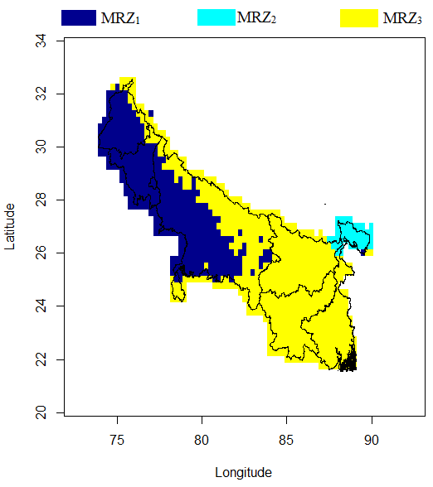
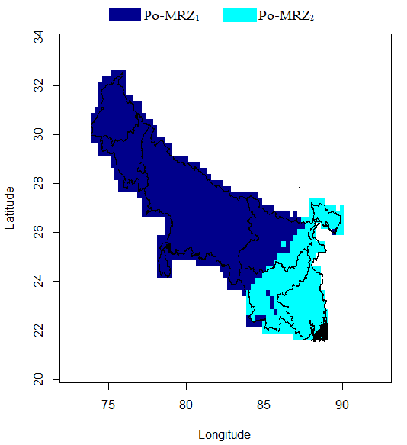
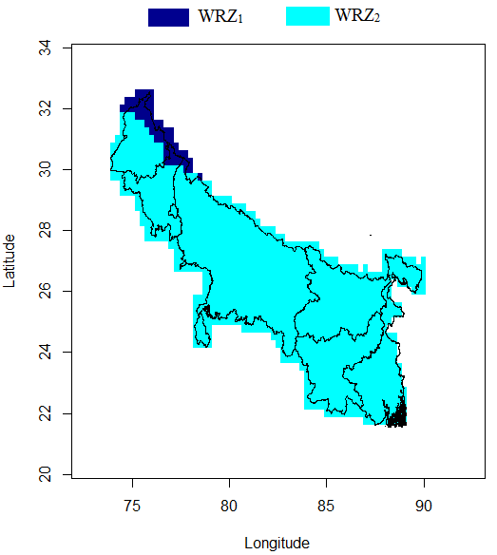
Case study 1: Over Indo Gangetic plane (IGP)
Identification season-wise rainfall homogeneous zone zone using K-means clustering algarithms over IGP of India
High resolution (0.25° × 0.25°) gridded rainfall data from the Indian Meteorological Department (IMD) during the period of 1961-2020 was used in the clustering.
For premonsoon season: 3 zones
For Monsoon season: 3 zones
For Post monsoon season: 2 zones
For winter season: 2 zones

Slide 27
Advanced ML Algorithms
Common supervised learning algorithms include:
  Support Vector Machines (SVM)
  Decision Trees and Random Forests (RF)
  Neural Networks
  K-Nearest Neighbour (KNN)
  Gradient Boosting Method (GBM)

Slide 28
Zone wise variation of Correlation for different methods
Comparison of R² value during calibration period (1961-2000) for Monsoon Rainfall Zones in IGP
 |  | MLR |  |  |  | RF |  |  |  | KNN |  |  |  | GBM
 |  | R² |  |  |  | R² |  |  |  | R² |  |  |  | R²
Predictor | MRZ₁ | MRZ₂ | MRZ₃ |  | MRZ₁ | MRZ₂ | MRZ₃ |  | MRZ₁ | MRZ₂ | MRZ₃ |  | MRZ₁ | MRZ₂ | MRZ₃
ta500 | 0.491 | 0.07 | 0.319 |  | 0.444 | 0.31 | 0.497 |  | 0.52 | 0.332 | 0.489 |  | 0.522 | 0.484 | 0.579
ta850 | 0.408 | 0.257 | 0.4 |  | 0.509 | 0.384 | 0.265 |  | 0.486 | 0.259 | 0.31 |  | 0.474 | 0.534 | 0.486
ta1000 | 0.466 | 0.162 | 0.423 |  | 0.427 | 0.205 | 0.369 |  | 0.429 | 0.169 | 0.556 |  | 0.563 | 0.56 | 0.55
z500 | 0.292 | 0.246 | 0.333 |  | 0.631 | 0.389 | 0.554 |  | 0.445 | 0.446 | 0.52 |  | 0.542 | 0.367 | 0.514
z850 | 0.427 | 0.346 | 0.366 |  | 0.488 | 0.386 | 0.379 |  | 0.432 | 0.429 | 0.467 |  | 0.473 | 0.313 | 0.446
z1000 | 0.431 | 0.329 | 0.367 |  | 0.402 | 0.371 | 0.419 |  | 0.537 | 0.442 | 0.384 |  | 0.475 | 0.498 | 0.44
u500 | 0.468 | 0.393 | 0.431 |  | 0.703 | 0.393 | 0.424 |  | 0.591 | 0.365 | 0.414 |  | 0.682 | 0.426 | 0.434
u850 | 0.387 | 0.44 | 0.437 |  | 0.411 | 0.503 | 0.265 |  | 0.382 | 0.442 | 0.308 |  | 0.408 | 0.471 | 0.293
u1000 | 0.445 | 0.241 | 0.303 |  | 0.236 | 0.591 | 0.441 |  | 0.449 | 0.481 | 0.331 |  | 0.338 | 0.348 | 0.508
v500 | 0.359 | 0.152 | 0.328 |  | 0.509 | 0.345 | 0.258 |  | 0.344 | 0.405 | 0.506 |  | 0.497 | 0.391 | 0.446
v850 | 0.626 | 0.38 | 0.614 |  | 0.498 | 0.494 | 0.53 |  | 0.428 | 0.524 | 0.402 |  | 0.478 | 0.57 | 0.493
v1000 | 0.449 | 0.358 | 0.584 |  | 0.258 | 0.477 | 0.208 |  | 0.308 | 0.575 | 0.406 |  | 0.496 | 0.622 | 0.401
sh500 | 0.657 | 0.324 | 0.71 |  | 0.657 | 0.318 | 0.554 |  | 0.62 | 0.418 | 0.556 |  | 0.654 | 0.43 | 0.508
sh850 | 0.567 | 0.327 | 0.755 |  | 0.523 | 0.327 | 0.515 |  | 0.435 | 0.414 | 0.57 |  | 0.528 | 0.291 | 0.514
sh1000 | 0.609 | 0.219 | 0.633 |  | 0.568 | 0.282 | 0.506 |  | 0.575 | 0.379 | 0.466 |  | 0.51 | 0.511 | 0.57
rh500 | 0.618 | 0.527 | 0.753 |  | 0.474 | 0.526 | 0.356 |  | 0.551 | 0.586 | 0.368 |  | 0.529 | 0.62 | 0.375
rh850 | 0.547 | 0.429 | 0.772 |  | 0.626 | 0.378 | 0.564 |  | 0.547 | 0.251 | 0.646 |  | 0.558 | 0.363 | 0.59
rh1000 | 0.619 | 0.252 | 0.745 |  | 0.569 | 0.355 | 0.315 |  | 0.487 | 0.5 | 0.612 |  | 0.632 | 0.359 | 0.555
slp | 0.405 | 0.33 | 0.431 |  | 0.463 | 0.417 | 0.303 |  | 0.455 | 0.357 | 0.515 |  | 0.5 | 0.444 | 0.351
prw | 0.491 | 0.238 | 0.673 |  | 0.41 | 0.285 | 0.405 |  | 0.506 | 0.367 | 0.458 |  | 0.409 | 0.468 | 0.402
prate | 0.623 | 0.627 | 0.779 |  | 0.385 | 0.476 | 0.39 |  | 0.359 | 0.473 | 0.536 |  | 0.475 | 0.599 | 0.283
nino3.4sst | 0.339 | 0.063 | 0.175 |  | 0.456 | 0.313 | 0.56 |  | 0.317 | 0.328 | 0.445 |  | 0.549 | 0.436 | 0.379

Slide 29
Zone wise variation of Correlation for different methods
Comparison of statistical indices (R, D,NSE,RSR) during validation period (2001-2020) of between MLR, RF, KNN, GBM method for monsoon rainfall zone in IGP
 |  |  |  |  |  |  | MLR
 |  | MRZ₁ |  |  |  |  | MRZ₂ |  |  |  |  | MRZ₃
Predictor | R | D | NSE | RSR |  | R | D | NSE | RSR |  | R | D | NSE | RSR
ta500 | 0.254 | 0.538 | -0.84 | 1.322 |  | 0.136 | 0.368 | -0.16 | 1.05 |  | -0.029 | 0.331 | -1.53 | 1.55
ta850 | 0.13 | 0.437 | -0.943 | 1.359 |  | -0.102 | 0.307 | -1.125 | 1.421 |  | 0.456 | 0.605 | -0.773 | 1.298
ta1000 | 0.237 | 0.519 | -0.839 | 1.322 |  | 0.065 | 0.379 | -0.514 | 1.199 |  | 0.182 | 0.489 | -1.361 | 1.498
z500 | -0.253 | 0.253 | -1.331 | 1.488 |  | 0.495 | 0.709 | 0.012 | 0.969 |  | 0.002 | 0.397 | -1.509 | 1.544
z850 | 0.417 | 0.625 | -0.461 | 1.178 |  | -0.238 | 0.315 | -1.755 | 1.618 |  | 0.499 | 0.618 | -0.648 | 1.251
z1000 | 0.357 | 0.573 | -0.573 | 1.222 |  | -0.293 | 0.3 | -1.8 | 1.631 |  | 0.365 | 0.571 | -0.902 | 1.344
u500 | 0.134 | 0.456 | -1.034 | 1.39 |  | 0.768 | 0.86 | 0.383 | 0.766 |  | 0.388 | 0.588 | -0.955 | 1.363
u850 | 0.1 | 0.44 | -0.962 | 1.365 |  | 0.39 | 0.613 | -0.6 | 1.233 |  | 0.092 | 0.466 | -1.577 | 1.565
u1000 | 0.257 | 0.537 | -0.773 | 1.298 |  | 0.141 | 0.397 | -0.622 | 1.241 |  | 0.437 | 0.607 | -0.684 | 1.265
v500 | 0.457 | 0.619 | -0.329 | 1.123 |  | 0.09 | 0.444 | -0.445 | 1.172 |  | -0.647 | 0.106 | -2.659 | 1.864
v850 | 0.531 | 0.695 | -0.43 | 1.166 |  | -0.035 | 0.351 | -1.432 | 1.52 |  | 0.079 | 0.489 | -2.009 | 1.691
v1000 | 0.329 | 0.555 | -0.645 | 1.25 |  | -0.289 | 0.289 | -1.916 | 1.664 |  | 0.151 | 0.497 | -1.767 | 1.621
sh500 | 0.363 | 0.585 | -0.833 | 1.32 |  | 0.568 | 0.752 | 0.035 | 0.958 |  | -0.081 | 0.327 | -2.652 | 1.863
sh850 | 0.304 | 0.558 | -0.844 | 1.324 |  | -0.14 | 0.336 | -1.468 | 1.531 |  | 0.093 | 0.412 | -2.294 | 1.769
sh1000 | 0.259 | 0.524 | -0.997 | 1.377 |  | -0.287 | 0.281 | -1.302 | 1.479 |  | 0.098 | 0.462 | -2.004 | 1.689
rh500 | 0.297 | 0.555 | -0.927 | 1.353 |  | -0.324 | 0.189 | -2.724 | 1.881 |  | 0.251 | 0.476 | -1.86 | 1.648
rh850 | 0.349 | 0.561 | -0.726 | 1.281 |  | 0.164 | 0.523 | -1.124 | 1.421 |  | 0.063 | 0.4 | -2.416 | 1.801
rh1000 | 0.252 | 0.526 | -1.025 | 1.387 |  | -0.164 | 0.255 | -1.22 | 1.452 |  | 0.051 | 0.38 | -2.384 | 1.793
slp | 0.419 | 0.625 | -0.434 | 1.167 |  | -0.391 | 0.262 | -2.014 | 1.692 |  | 0.199 | 0.479 | -1.343 | 1.492
prw | 0.545 | 0.688 | -0.281 | 1.103 |  | -0.061 | 0.371 | -0.977 | 1.371 |  | 0.214 | 0.432 | -1.795 | 1.629
prate | 0.199 | 0.465 | -1.145 | 1.428 |  | -0.107 | 0.25 | -2.511 | 1.826 |  | 0.581 | 0.689 | -0.998 | 1.378
nino3.4sst | 0.312 | 0.537 | -0.545 | 1.212 |  | 0.343 | 0.497 | 0.048 | 0.951 |  | 0.367 | 0.574 | -0.643 | 1.249

Slide 30
Zone wise variation of Correlation for different methods
 |  |  |  |  |  |  | RF
 |  | MRZ₁ |  |  |  |  | MRZ₂ |  |  |  |  | MRZ₃
Predictor | R | D | NSE | RSR |  | R | D | NSE | RSR |  | R | D | NSE | RSR
ta500 | 0.224 | 0.538 | -0.407 | 1.156 |  | 0.049 | 0.396 | -0.545 | 1.211 |  | -0.003 | 0.402 | -0.885 | 1.338
ta850 | 0.16 | 0.473 | -0.332 | 1.125 |  | -0.033 | 0.358 | -0.463 | 1.179 |  | 0.568 | 0.573 | -0.43 | 1.165
ta1000 | 0.157 | 0.491 | -0.606 | 1.235 |  | 0.045 | 0.295 | -0.29 | 1.107 |  | 0.393 | 0.549 | -0.486 | 1.188
z500 | -0.324 | 0.279 | -1.633 | 1.581 |  | 0.562 | 0.724 | 0.248 | 0.845 |  | -0.173 | 0.343 | -1.611 | 1.575
z850 | 0.379 | 0.574 | -0.238 | 1.084 |  | 0.019 | 0.401 | -0.757 | 1.292 |  | 0.441 | 0.574 | -0.38 | 1.145
z1000 | 0.326 | 0.498 | -0.204 | 1.069 |  | 0.008 | 0.406 | -0.697 | 1.27 |  | 0.223 | 0.507 | -0.549 | 1.213
u500 | 0.201 | 0.481 | -0.695 | 1.269 |  | 0.613 | 0.723 | 0.168 | 0.889 |  | 0.331 | 0.511 | -0.929 | 1.354
u850 | -0.034 | 0.367 | -0.631 | 1.245 |  | 0.377 | 0.592 | -0.062 | 1.005 |  | 0.091 | 0.445 | -0.746 | 1.288
u1000 | 0.139 | 0.444 | -0.407 | 1.156 |  | 0.052 | 0.305 | -0.286 | 1.105 |  | 0.484 | 0.568 | -0.471 | 1.182
v500 | 0.219 | 0.431 | -0.324 | 1.121 |  | 0.218 | 0.483 | -0.093 | 1.019 |  | -0.541 | 0.223 | -1.295 | 1.476
v850 | 0.586 | 0.613 | -0.139 | 1.04 |  | 0.117 | 0.382 | -0.31 | 1.116 |  | 0.191 | 0.501 | -1.06 | 1.399
v1000 | 0.112 | 0.375 | -0.281 | 1.103 |  | -0.098 | 0.356 | -0.892 | 1.341 |  | 0.232 | 0.494 | -0.492 | 1.19
sh500 | 0.42 | 0.579 | -0.197 | 1.067 |  | 0.539 | 0.678 | 0.236 | 0.852 |  | -0.024 | 0.385 | -0.876 | 1.335
sh850 | 0.248 | 0.486 | -0.352 | 1.133 |  | -0.088 | 0.306 | -0.584 | 1.227 |  | 0.026 | 0.41 | -0.795 | 1.306
sh1000 | 0.256 | 0.491 | -0.331 | 1.125 |  | -0.047 | 0.344 | -0.346 | 1.131 |  | 0.068 | 0.469 | -0.696 | 1.269
rh500 | 0.401 | 0.57 | -0.23 | 1.081 |  | -0.417 | 0.196 | -1.559 | 1.559 |  | 0.296 | 0.508 | -0.602 | 1.234
rh850 | 0.117 | 0.442 | -0.751 | 1.29 |  | 0.114 | 0.452 | -0.191 | 1.064 |  | 0.212 | 0.451 | -1.008 | 1.381
rh1000 | 0.231 | 0.507 | -0.434 | 1.167 |  | 0.003 | 0.258 | -0.214 | 1.074 |  | -0.093 | 0.374 | -0.846 | 1.324
slp | 0.43 | 0.595 | -0.1 | 1.022 |  | 0.018 | 0.403 | -1.093 | 1.41 |  | 0.339 | 0.533 | -0.458 | 1.177
prw | 0.544 | 0.642 | -0.161 | 1.05 |  | -0.228 | 0.28 | -0.747 | 1.288 |  | 0.427 | 0.538 | -0.374 | 1.142
prate | -0.01 | 0.378 | -0.471 | 1.182 |  | -0.156 | 0.241 | -0.283 | 1.104 |  | 0.559 | 0.577 | -0.484 | 1.187
nino3.4sst | 0.193 | 0.467 | -0.669 | 1.259 |  | 0.274 | 0.526 | -0.201 | 1.068 |  | 0.476 | 0.626 | -0.329 | 1.124

Slide 31
Zone wise variation of Correlation for different methods
 |  |  |  |  |  |  | KNN
 |  | MRZ₁ |  |  |  |  | MRZ₂ |  |  |  |  | MRZ₃
Predictor | R | D | NSE | RSR |  | R | D | NSE | RSR |  | R | D | NSE | RSR
ta500 | 0.201 | 0.496 | -0.603 | 1.234 |  | 0.127 | 0.274 | -0.036 | 0.992 |  | -0.186 | 0.374 | -0.85 | 1.326
ta850 | 0.06 | 0.421 | -0.761 | 1.293 |  | -0.03 | 0.231 | -0.17 | 1.054 |  | 0.522 | 0.549 | -0.394 | 1.151
ta1000 | 0.141 | 0.462 | -0.513 | 1.199 |  | 0.108 | 0.265 | -0.084 | 1.015 |  | 0.042 | 0.44 | -0.795 | 1.306
z500 | -0.501 | 0.298 | -0.945 | 1.359 |  | 0.34 | 0.36 | 0.034 | 0.958 |  | -0.014 | 0.417 | -0.937 | 1.356
z850 | 0.334 | 0.513 | -0.385 | 1.147 |  | -0.233 | 0.205 | -0.224 | 1.078 |  | 0.508 | 0.513 | -0.63 | 1.244
z1000 | 0.361 | 0.504 | -0.334 | 1.126 |  | -0.315 | 0.223 | -0.337 | 1.127 |  | 0.245 | 0.467 | -0.727 | 1.281
u500 | 0.04 | 0.438 | -0.526 | 1.204 |  | 0.582 | 0.599 | 0.247 | 0.846 |  | 0.333 | 0.47 | -0.451 | 1.174
u850 | -0.133 | 0.344 | -0.907 | 1.346 |  | 0.355 | 0.365 | 0.065 | 0.943 |  | 0.104 | 0.448 | -0.615 | 1.239
u1000 | 0.078 | 0.4 | -0.462 | 1.179 |  | 0.099 | 0.203 | -0.027 | 0.988 |  | 0.222 | 0.451 | -0.59 | 1.229
v500 | 0.444 | 0.532 | -0.283 | 1.104 |  | 0.176 | 0.27 | -0.015 | 0.982 |  | -0.407 | 0.339 | -0.903 | 1.344
v850 | 0.436 | 0.564 | -0.319 | 1.119 |  | -0.054 | 0.22 | -0.14 | 1.041 |  | 0.249 | 0.481 | -0.558 | 1.217
v1000 | 0.39 | 0.519 | -0.392 | 1.15 |  | -0.1 | 0.274 | -0.226 | 1.079 |  | 0.189 | 0.485 | -0.729 | 1.282
sh500 | 0.084 | 0.414 | -0.615 | 1.239 |  | 0.265 | 0.394 | -0.007 | 0.978 |  | 0.153 | 0.459 | -0.619 | 1.24
sh850 | 0.173 | 0.456 | -0.467 | 1.181 |  | -0.029 | 0.264 | -0.124 | 1.033 |  | 0.123 | 0.443 | -0.737 | 1.284
sh1000 | 0.365 | 0.481 | -0.366 | 1.139 |  | -0.362 | 0.154 | -0.173 | 1.056 |  | 0.071 | 0.464 | -0.871 | 1.333
rh500 | 0.208 | 0.472 | -0.412 | 1.158 |  | -0.42 | 0.161 | -0.627 | 1.243 |  | 0.12 | 0.425 | -0.802 | 1.309
rh850 | 0.199 | 0.428 | -0.479 | 1.185 |  | 0.145 | 0.369 | -0.066 | 1.007 |  | 0.294 | 0.465 | -0.599 | 1.233
rh1000 | 0.154 | 0.444 | -0.511 | 1.198 |  | -0.251 | 0.211 | -0.171 | 1.055 |  | 0.421 | 0.518 | -0.465 | 1.18
slp | 0.458 | 0.542 | -0.451 | 1.174 |  | -0.039 | 0.329 | -0.494 | 1.191 |  | 0.067 | 0.45 | -0.905 | 1.345
prw | 0.326 | 0.502 | -0.517 | 1.2 |  | -0.076 | 0.251 | -0.178 | 1.058 |  | 0.391 | 0.518 | -0.568 | 1.221
prate | 0.044 | 0.432 | -0.51 | 1.198 |  | -0.027 | 0.316 | -0.294 | 1.109 |  | 0.238 | 0.505 | -0.675 | 1.262
nino3.4sst | 0.371 | 0.528 | -0.31 | 1.116 |  | 0.338 | 0.512 | 0.032 | 0.959 |  | 0.528 | 0.594 | -0.476 | 1.184

Slide 32
Zone wise variation of Correlation for different methods
 |  |  |  |  |  |  | GBM
 |  | MRZ₁ |  |  |  |  | MRZ₂ |  |  |  |  | MRZ₃
Predictor | R | D | NSE | RSR |  | R | D | NSE | RSR |  | R | D | NSE | RSR
ta500 | 0.259 | 0.572 | -0.325 | 1.122 |  | 0.221 | 0.483 | -0.452 | 1.175 |  | 0.046 | 0.408 | -1.686 | 1.597
ta850 | 0.197 | 0.493 | -0.316 | 1.118 |  | -0.171 | 0.216 | -0.63 | 1.245 |  | 0.43 | 0.547 | -0.511 | 1.198
ta1000 | 0.217 | 0.513 | -0.443 | 1.171 |  | 0.046 | 0.255 | -0.12 | 1.032 |  | 0.374 | 0.513 | -0.625 | 1.242
z500 | -0.237 | 0.346 | -1.397 | 1.509 |  | 0.395 | 0.609 | 0.014 | 0.968 |  | -0.222 | 0.354 | -1.109 | 1.416
z850 | 0.43 | 0.619 | -0.206 | 1.07 |  | -0.067 | 0.294 | -0.206 | 1.07 |  | 0.363 | 0.583 | -0.642 | 1.249
z1000 | 0.367 | 0.55 | -0.059 | 1.003 |  | -0.093 | 0.352 | -0.417 | 1.16 |  | 0.05 | 0.428 | -1.448 | 1.525
u500 | 0.394 | 0.571 | -0.647 | 1.251 |  | 0.644 | 0.753 | 0.294 | 0.819 |  | 0.291 | 0.52 | -1.45 | 1.526
u850 | 0.02 | 0.42 | -0.548 | 1.213 |  | 0.266 | 0.495 | -0.245 | 1.088 |  | -0.007 | 0.452 | -0.763 | 1.294
u1000 | 0.229 | 0.499 | -0.364 | 1.138 |  | 0.067 | 0.254 | -0.084 | 1.015 |  | 0.326 | 0.478 | -0.674 | 1.261
v500 | 0.225 | 0.429 | -0.31 | 1.116 |  | 0.094 | 0.305 | -0.078 | 1.012 |  | -0.166 | 0.417 | -0.729 | 1.282
v850 | 0.635 | 0.735 | 0.012 | 0.969 |  | -0.058 | 0.286 | -0.787 | 1.303 |  | 0.228 | 0.515 | -1.093 | 1.41
v1000 | 0.058 | 0.374 | -0.852 | 1.327 |  | 0.052 | 0.33 | -0.212 | 1.073 |  | -0.018 | 0.425 | -0.804 | 1.309
sh500 | 0.358 | 0.545 | -0.231 | 1.081 |  | 0.507 | 0.57 | 0.172 | 0.887 |  | -0.318 | 0.261 | -4.125 | 2.207
sh850 | 0.305 | 0.497 | -0.312 | 1.116 |  | -0.142 | 0.206 | -0.256 | 1.092 |  | -0.156 | 0.34 | -1.696 | 1.6
sh1000 | 0.219 | 0.485 | -0.363 | 1.138 |  | 0.062 | 0.443 | -0.379 | 1.145 |  | 0.121 | 0.512 | -0.987 | 1.374
rh500 | 0.349 | 0.56 | -0.369 | 1.14 |  | -0.339 | 0.212 | -1.672 | 1.593 |  | 0.342 | 0.529 | -0.635 | 1.246
rh850 | 0.202 | 0.481 | -0.568 | 1.22 |  | 0.045 | 0.459 | -0.893 | 1.341 |  | 0.011 | 0.384 | -2.542 | 1.834
rh1000 | 0.254 | 0.501 | -0.482 | 1.187 |  | -0.142 | 0.155 | -0.171 | 1.055 |  | 0.207 | 0.446 | -1.097 | 1.411
slp | 0.488 | 0.652 | 0.008 | 0.971 |  | -0.052 | 0.301 | -0.363 | 1.138 |  | 0.169 | 0.486 | -0.561 | 1.218
prw | 0.486 | 0.569 | -0.184 | 1.061 |  | 0.137 | 0.307 | -0.091 | 1.018 |  | 0.177 | 0.436 | -1.369 | 1.5
prate | -0.05 | 0.378 | -0.566 | 1.22 |  | -0.218 | 0.157 | -1.464 | 1.53 |  | 0.375 | 0.522 | -0.636 | 1.247
nino3.4sst | 0.209 | 0.466 | -0.829 | 1.318 |  | 0.417 | 0.376 | 0.074 | 0.938 |  | 0.477 | 0.627 | -0.22 | 1.077

Slide 33
Conclusion
Downscaling is essential to reduce bias and uncertainty of raw GCMs or RCMs outputs.
Methods of downscaling play a crucial role. Simple MLR methods like (MOS or PP methods) having some merits and demerits. Machine Learning downscaling expected to be produce improved downscaling products due to the learning abilities from data and their use in computer algorithms
For each downscaling process, selection of suitable predictor and suitable predictor domain is very challenging to get reliable downscscale products
The potential for machine learning in climate science continues to grow with advanced modelling techniques and enhanced climate predictions.

Slide 34
Possible recommendations
Multi-level stakeholders should have high resolution downscaled climate change information beforehand to implement any adaptation and mitigation option towards combating climate change at local level
To adequately assess the impact of climate change on agricultural sector, crop specific process based crop simulation models must run using local Scale downscaling information as inputs instead of raw GCMs to produce future productivity scenarios to put more confident on results

Slide 35


